Slide 1
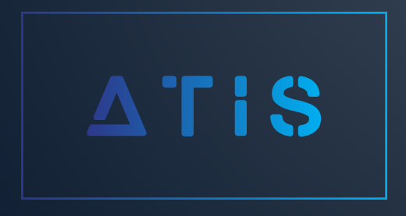
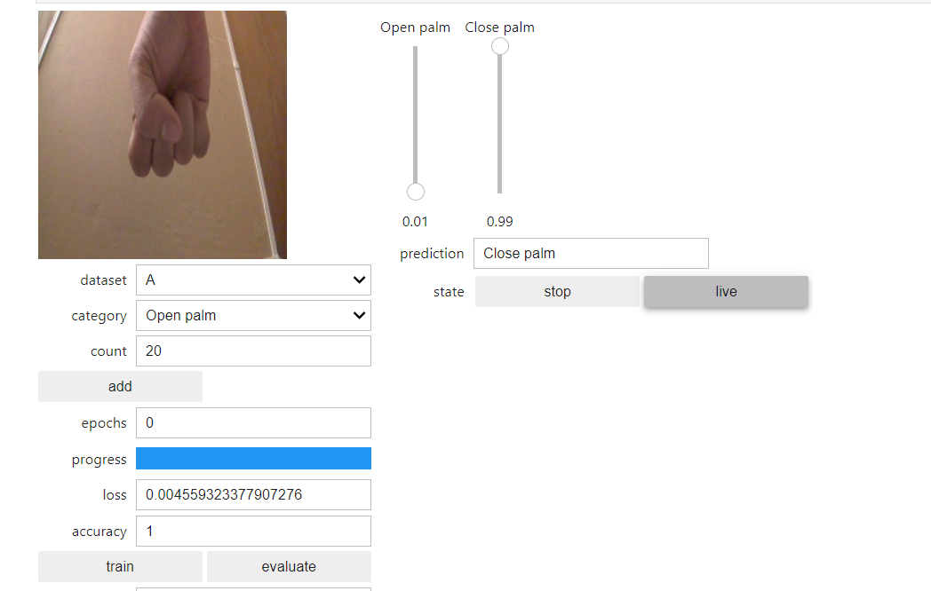
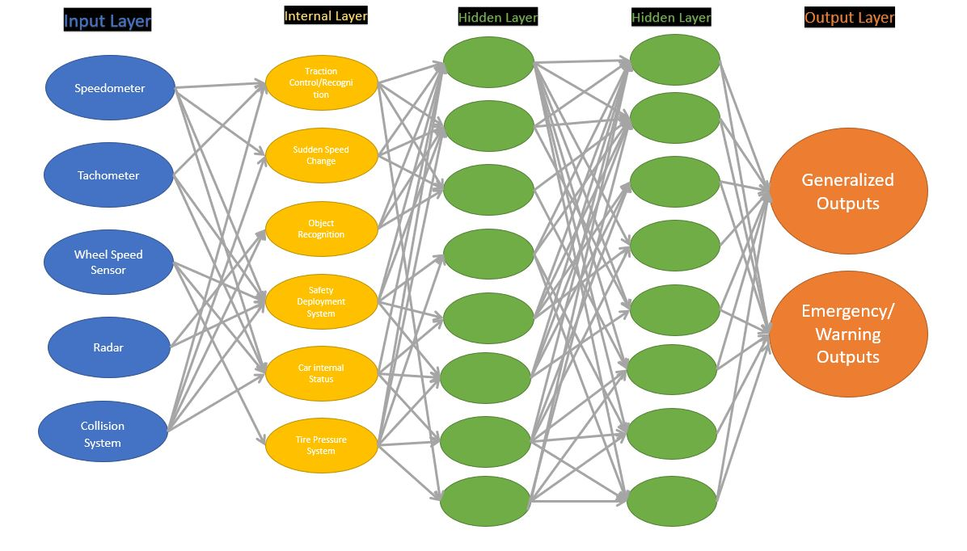
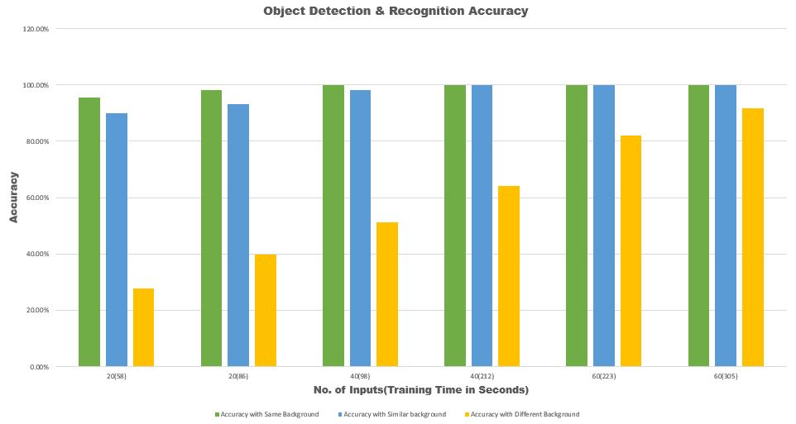
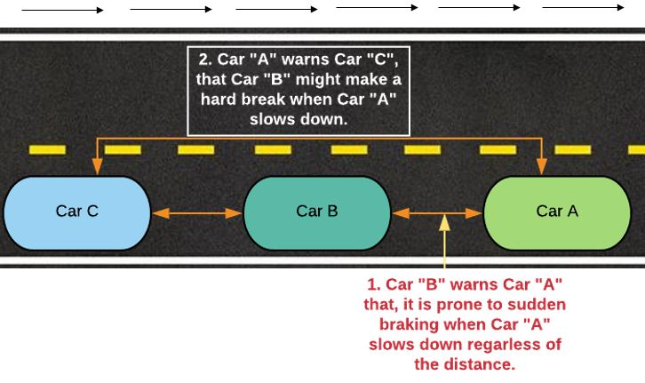


ATIS – Advanced Traffic Management System
Author: Abdul H Mohammed
ENG- 271W Technical Communication
ABSTRACT
METHODOLOGY
SYSTEM DESIGN
We currently live in an era where science and technology run the world. Most of the common things around us are getting advanced, intelligent and smart. This doesn’t necessarily mean everything. One of the things that are getting better every day is transportation. Driving experience today has completely changed when compared to driving back in the 60s or 70s. Vehicles are now safer, advanced, intelligent and becoming eco-friendlier as we progress. Autonomous vehicles are getting more common as we move forward. One thing that has not changed since its introduction is the way traffic operates, roads and highways. As vehicles that drive on it get smarter, we find it necessary to make the functions of the traffic and roads advanced and intelligent. Hence, the creation of ATIS (Advanced Traffic Integration System). One of the core ideas behind ATIS to create a smarter and safer way to deal with day to day traffic operations, the way cars drive on the roads, etc. It is a device that can connect the vehicles with its surrounding environment, including road signs, traffic lights, law enforcement, etcetera without using expensive and bulky hardware.
Multiple approaches have been proposed by the ATIS team to create the methodology for the system. One thing that the team found necessary was the use of neural network for the system to find and solve multiple tasks with appropriate solutions.
ATIS Functionality
In general, ATIS processes necessary data like when a car is about to make a complete stop, drastic speed change, turn, incoming pedestrian, just like V2V but on the advanced side of ATIS, using machine learning it records, collects and analyzes driver’s driving habits, frequent mistakes, reactions and way of driving in different road and weather conditions, reactions & habits on long drives, congested roads, etc. After analyzing the data, it sends out data to other drivers in the surrounding on a need to know basis or just as a cautious and alert warning and in many cases to the traffic signals and road signs.
An Example of ATIS Features
An example of how ATIS works and is beneficial in the following case: The driver of Car B as shown figure 4 is a beginner driver and is prone to sudden braking or hard braking when he sees a car in front of him slowing down(Car A), regardless of the distance between the two cars. Car B’s sudden stop on a highspeed highway might be lethal to Car B and the car behind it, which is Car C, both cars most likely might collide. Given that all cars in our situation are equipped with ATIS devices, ATIS device installed in Car B is familiar with the Driver’s habits, it sends an alert to Car A’s ATIS about this particular habit in case Car A might slow down. When car A slows down or is about to slow down, Car A sends out an alert to the ATIS device of Car C to slow down and be cautious in case Car B might make use of hard breaks. Hence preventing a collision.
figure 2: Example of the Test
After multiple steps, trial & error and increased amount of data and training time given to the machine, it was able to accurately recognize if the hand is closed or not with a confidence of 99%.
figure 1 : Basic Neural Network
A neural network similar to the one shown in figure 1 is what the ATIS team is targeting to create. This neural network is layer based, the first layer (colored in blue) is a layer which recognizes the inputs using the sensors and equipment that are readily available in most modern vehicles including but not limited to built-in radar, camera, proximity sensor, etc. The internal layers of the neural network further simplify the data, combines it and finds the appropriate solutions to give a final result or solution through the final output layer. The first layer (colored in blue) is a layer which recognizes the inputs using the sensors and equipment that are readily available in most modern vehicles including but not limited to built-in radar, camera, proximity sensor, etc. The internal layers of the neural network further simplify the data, combines it and finds the appropriate solutions to give a result or solution through the final output layer.
A global pointing system (GPS) will be equipped in the system or pre-installed. The GPS plays a crucial role to recognize the virtual grid system which will be created specifically for the ATIS system to point the coordinates of a vehicle equipped with the ATIS device. It will also help for updating real time vehicle location that can be useful in many directions for emergency and law enforcement services.
The ATIS system uses machine learning to give an accurate solution or an output to a given input. There is no specific method or an algorithm to determine the amount of data needed to give an accurate output nor is there a way to determine the number of layers to be required by a neural network to produce an output. Due to this reason, the team had to determine the amount of data needed for a machine to analyze to produce an accurate output manually using the trail and error method. Accurate data is very crucial for the system to work successfully.
As a proof of concept, the team initiated an experiment to determine the amount of data required in general to give an accurate result by using a machine learning hardware created by Nvidia. The device is known as Nvidia Jetson Nano.
The goal of the experiment was to determine the amount of training time and data needed for the computer to successfully recognize if a human hand is closed or open. At first, the machine was given limited amount of data, in this case, the data was the pictures of a closed and open hand. The machine was also given limited amount of training time.
INTRODUCTION
One of the main concepts behind the idea is to invent a device (ATIS), that can be equipped to vehicles, traffic signals, road signs etc. We currently have the technology where a vehicle can detect surrounding vehicles speed, collisions, pedestrians and other stuff using the conventional radar system and object recognition cameras. This is just one-way communication. Although some vehicle manufacturers like Tesla have bit advanced feature where there might be a limited intelligent communication between vehicles if there are from the same manufacturers. We plan to achieve a fully establish two-way intelligent communication between vehicles regardless of them being from different manufacturers using ATIS. ATIS will also be open source to some extend allowing vehicle manufacturers to customize and comply the device according to their requirements and business models.
figure 3 : Object Detection & Recognition Accuracy
figure 4: Example of ATIS features
As shown in figure 3, the more training time and data given the more accurate the machine is. In conclusion, the more data ATIS gets on multiple things like driver’s driving behavior, the more outputs it will be able to give overtime.
In conclusion, the more data ATIS gets on multiple things like driver’s driving behavior, the more outputs it will be able to give overtime.
CHALLENGES & LIMITATIONS
One of the main challenges is that to take full advantage of an ATIS device, everything should be equipped with an ATIS device, this requires a huge budget for cities. Another challenge that would make is common among vehicle manufacturers. Even though the concept is to make ATIS an open source to make it customizable, it doesn’t always meet the requirements of many business models. From the perspective of research and tests, there hasn’t been any significant research done on any thing similar to ATIS which makes it challenging to see how much progress already exists in this particular field.
CONCLUSION
With the boom of technology, IoTs and the world getting closer to making a complete smart city, ATIS is a necessary addition. With the good possibly of driverless cars to be common on the road within a decade or two, The ATIS device should a mandatory addon on every vehicle on the road. ATIS is customizable to the point that its features can be added as it advances giving the developers limitless options and opportunity to take advantage of using machine learning and Artificial Intelligence.

